Slide 1



App Development
Learning Modules
Setting Up the Emulator
Developed August 2015

Slide 2

Emulator Setup
If you do not have an Android device, you can still build apps with App Inventor. App Inventor provides an Android emulator which works just like an Android device except on your computer screen. This does come with a few limitations however. For example, you can’t shake your computer monitor to simulate shaking an Android device. We still recommend using an Android device whenever possible.
Please ensure you are using Google Chrome before proceeding any further.

Slide 3
Emulator Setup
To use the emulator, you first need to install some software on your computer. Follow these directions:
Download the installer located here: http://appinv.us/aisetup_windows
Locate the file MIT_Appinventor_Tools_2.3.0 (~80 MB) in your Downloads file or your Desktop. The location of the download on your computer depends on how your browser is configured.
Open the file.
Click through the steps of the installer. Do not change the installation location but record the installation directory, because you might need it to check drivers later. The directory will differ depending on your version of Windows and whether or not you are logged in as an administrator.
You may be asked if you want to allow a program from an unknown publisher to make changes to this computer. Click yes.
In most cases, App Inventor should be able to locate the Setup software on its own. But if it asks for the location of the software, the path to enter is C:\Program Files\Appinventor\commands-for-Appinventor. If you are using a 64-bit machine ((How to tell if you're on 64-bit Windows), you should type Program Files (x86) rather than Program Files.

Slide 4
Emulator Setup
The next step is launching the emulator. This requires use of a program named “aiStarter”. This program is the helper that permits the browser to communicate with the emulator.
On Windows, there will be shortcuts to aiStarter from your Desktop, from the Start menu, from All Programs and from Startup Folder. If you want to use the emulator with App Inventor, you will need to manually launch aiStarter on your computer when you log in. You can start aiStarter this by clicking the icon on your desktop or using the entry in your start menu.

Slide 5
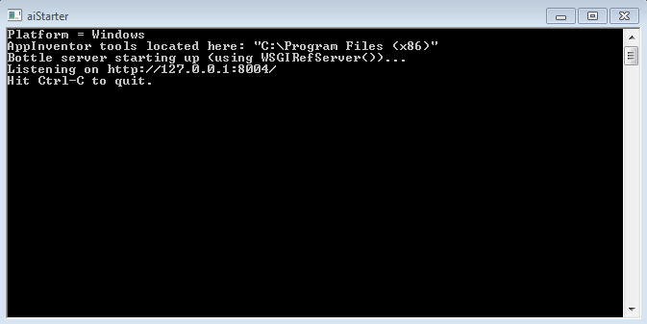
Emulator Setup
You will know you successfully launched aiStarter when you see a window that looks like this:

Slide 6
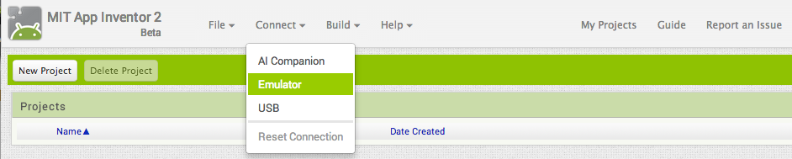
Emulator Setup
The next step is to connect your app inventor project to the emulator. Go to App Inventor and open a project (or create a new one – use Project > Start New Project and give your project a name).
Next, from the App Inventor’s menu, go to the Connect Menu and click the Emulator option.

Slide 7
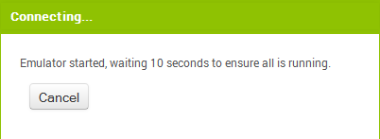
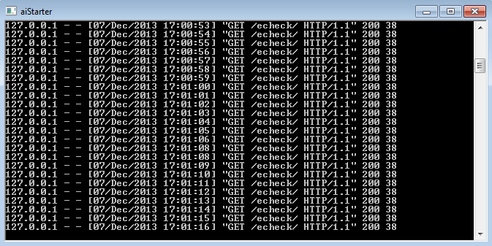
Emulator Setup
You will receive a notice stating that the emulator is connecting. This can take a couple of minutes and you will see screens like the below to indicate it is working:

Slide 8
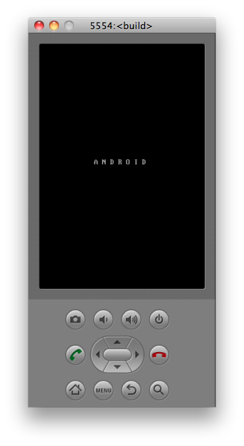
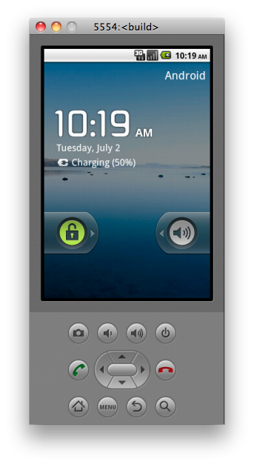
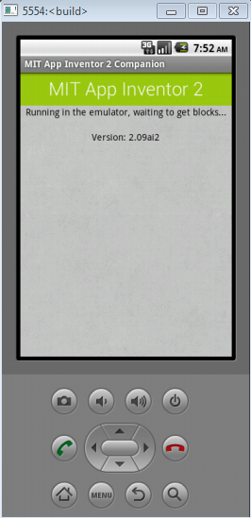
Emulator Setup
The emulator will initially appear with an empty black screen. #1 below.
Wait until it’s ready with a colored screen background. #2 below.
Even after the background appears, you should wait until the emulated phone has finished preparing its SD card – there will be a notice at the top of the screen while the card is being prepared. #3 below.
Once connected, the emulator will launch and show the app you have open in App Inventor.

Slide 9
Emulator Setup
If this is the first time you are using the emulator after installing the App Inventor Setup software, you will see a message asking you to update the emulator. Follow the directions on the screen to perform the update and reconnect the emulator. You will need to do this kind of update whenever there is a new version of the App Inventor software.
If you run into issues when running the emulator software, additional help can be located here: http://appinventor.mit.edu/explore/ai2/connection-help.html
Additionally, this page has directions on how to get to emulator setup for Mac or Linux: http://appinventor.mit.edu/explore/ai2/setup-emulator.html#step2

Slide 10



